Slide 1
Recurrent Neural Network
Kathan Sheth
CC - AS – ECE - NA

Slide 2
Part 1 - RNN
1. What is RNN?
2. RNN Example
3. Vanishing and exploding Gradient in Vanilla RNN
4. LSTM

Slide 3
Part 2 – German Traffic Sign Dataset Discussion
Discuss three implementation
Compare Accuracy, Loss on Validation and test data set
Discuss Data Augmentation, Regularization, Loss in each implementation
Discuss Train vs Validation accuracy graph and Train vs Validation loss graph.
Final model accuracy : 97.43% on test dataset.

Slide 4
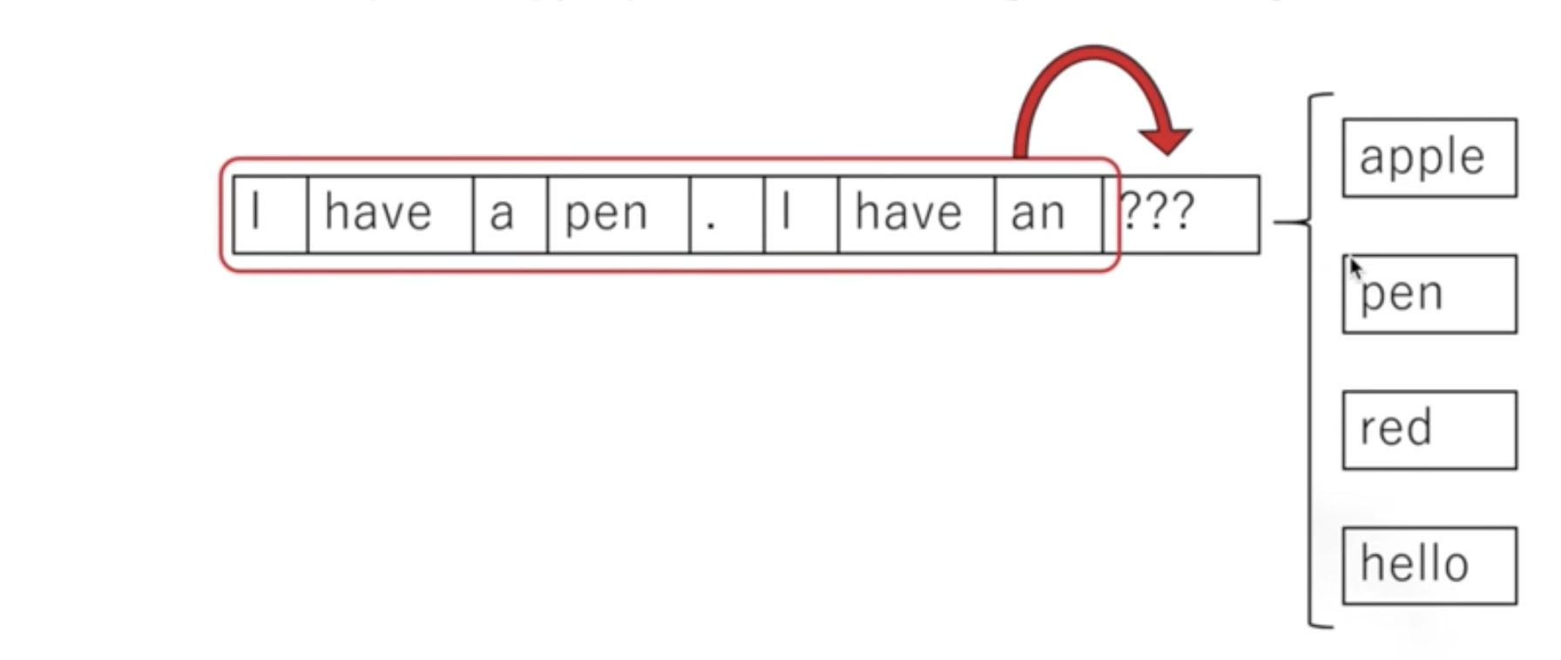
1. What is RNN? - Introduction
Recurrent Neural Network.
Useful for learning Sequential Data
Given some books, movie scripts or text corpus, the network will learn how to generate words in the style of corpus of text.
Notes:
Why can’t we use feedforward network ?
In image classification problem, network will provide Dog or Cat but classifying a cat has no relation with previous output (dog)
Output at time t has no relation with t-1
When we read some books, we understand it by understanding/remembering previous words which is not possible with only feed forward network.

Slide 5
1. What is RNN? – Introduction (Cont..)
We learn lyrics in a sequence. Kind of Conditional Memory. What we remember depends on previous memory
Hard to recall in backward. Even it is hard to pick from middle
Brain uses the “direction” from beginnig
Notes:
- Alphabet. Lyrics of a song. These are stored using conditional memory.
- Conditional memory, what you remember depends on what you have stored previously.
We feed the hidden state from the previous time step back into the network at the next time step.
-We cannot generate new frames in time t + 1 if we do not know a frame at time t.
-Other real life example - Stock Prediction , Text Generation (New Word, Next Character)

Slide 6
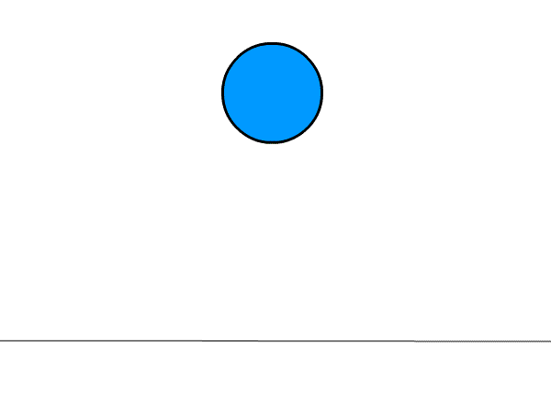
1. What is RNN? – Introduction (Cont..)
Each data point is a frame
If we want to train a NN to predict where the ball would be in next frame, then it would be helpful to know where the ball was in last frame
How does a NN remember what it saw in previous time step?

Slide 7
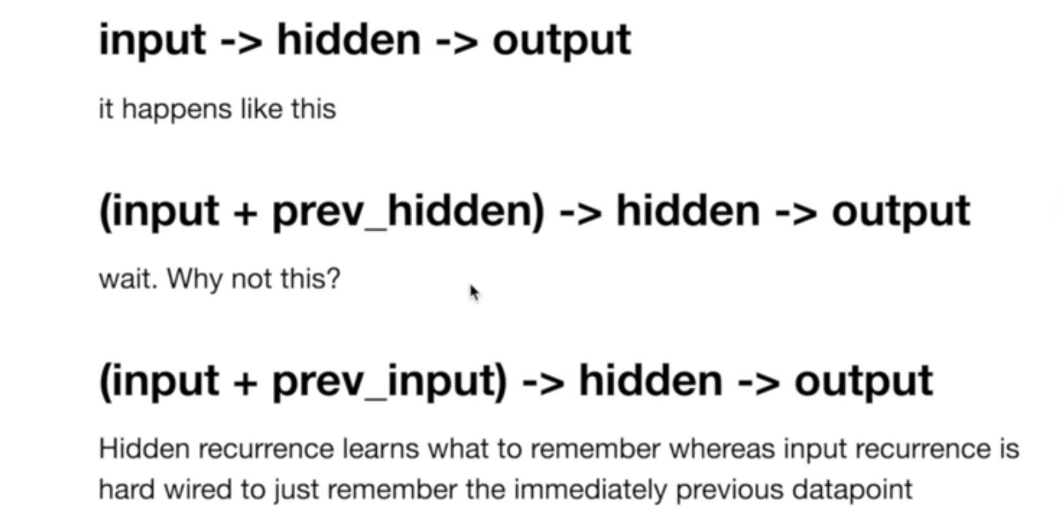
1. What is RNN? – Introduction (Cont..)
Answer :
Hidden Layer.
For NN
Notes:
Certain types of input create certain types of hidden layers. Certain types of hidden layers create certain types of output layers. It's kindof a closed system. Memory changes this. Memory means that the hidden layer is a combination of your input data at the current timestep and the hidden layer of the previous timestep.

Slide 8
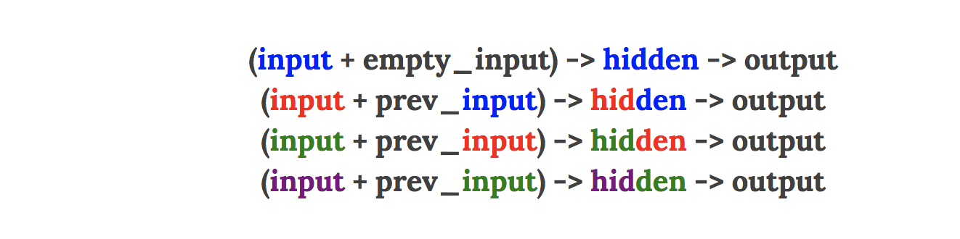
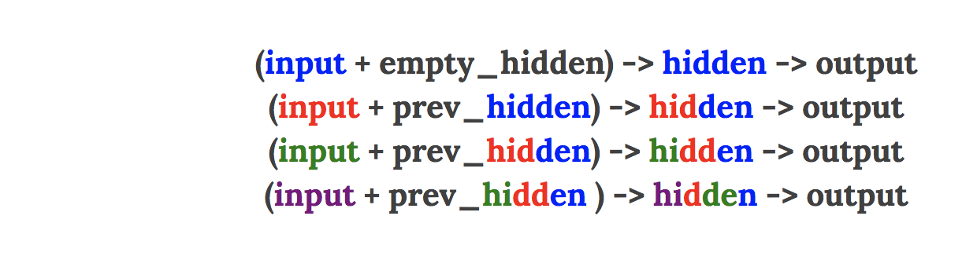
1. What is RNN? – Introduction (Cont..)
Why hidden layer instead of previous input layer?
Notes:
Hidden recurrence learns what to remember whereas input recurrence is hard wired to just remember the immediately previous datapoint.

Slide 9
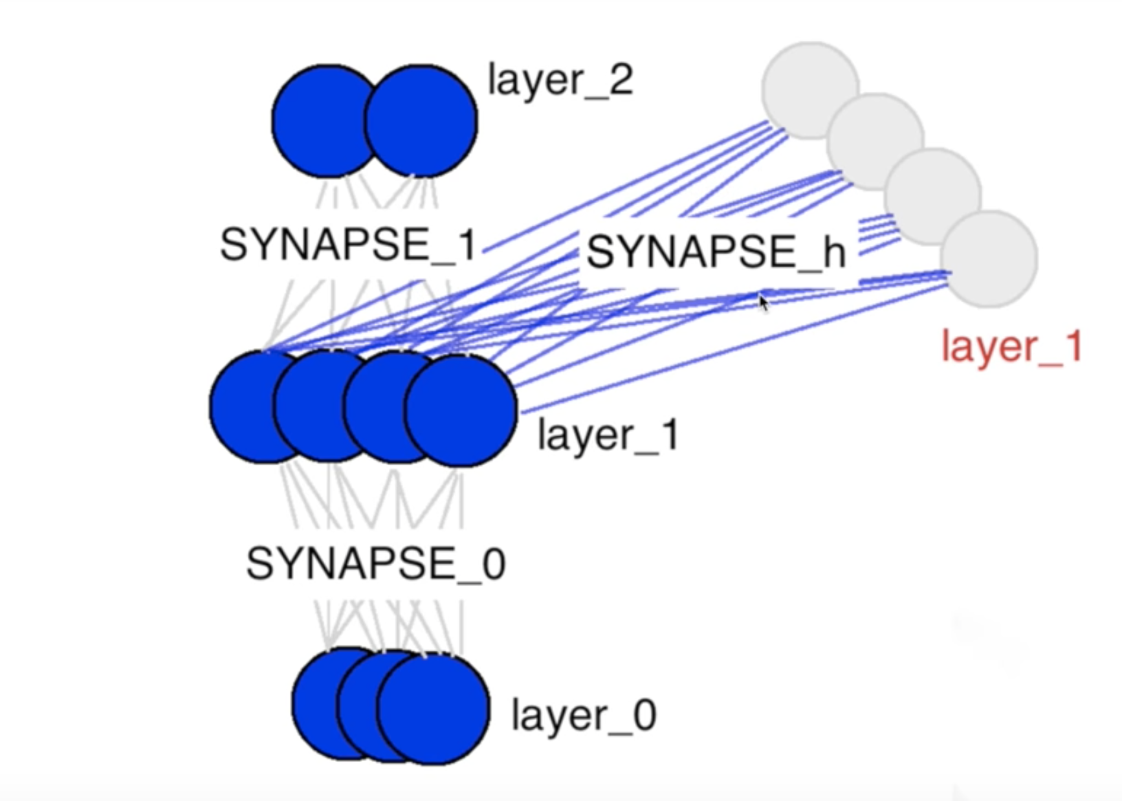
1. What is RNN? – Introduction (Cont..)
We have a two layer feed forward network same as usual NN
The only difference here is the new weight matrix which is shown in Red text (W_{hh}).
It is connecting hidden state at current time step to the hidden state at the previous time step.

Slide 10
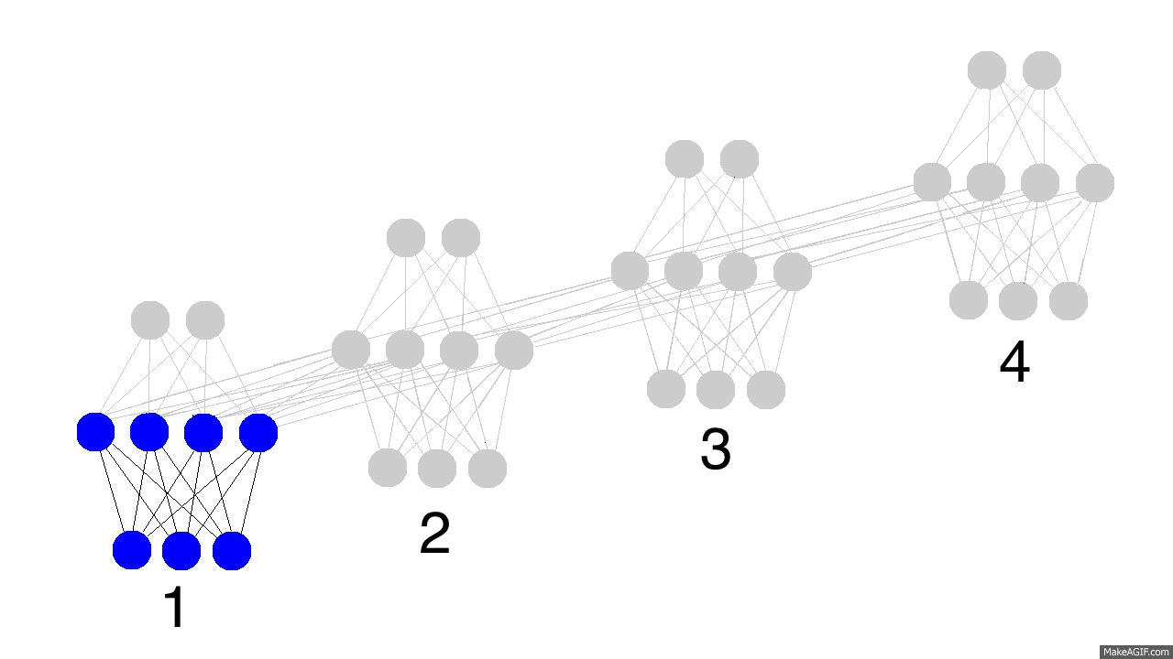
1. What is RNN? – Introduction (Cont..)
Notes:
-We have four timestamps here.
-The network is full at t4.
-So, at t5 it has to decide which memories it would keep and which one to overwrite.
-Bigger network can remember more.
-Also, this is when the network learns to forget irrelevant memories and remember important memories.
-The output is no longer a pure function of the input.
-The input is just changing what's in the memory, and the output is exclusively based on the memory.
-Another interesting takeaway. If there was no input at timesteps 2,3,and 4, the hidden layer would still change from timestep to timestep.

Slide 11

1. What is RNN? – Introduction (Cont..)
Notes:
How training is done? Backprop
Prediction in black
Error in yellow
Derivatives in Mustard.
Same weight for synapse 0,1,h

Slide 12
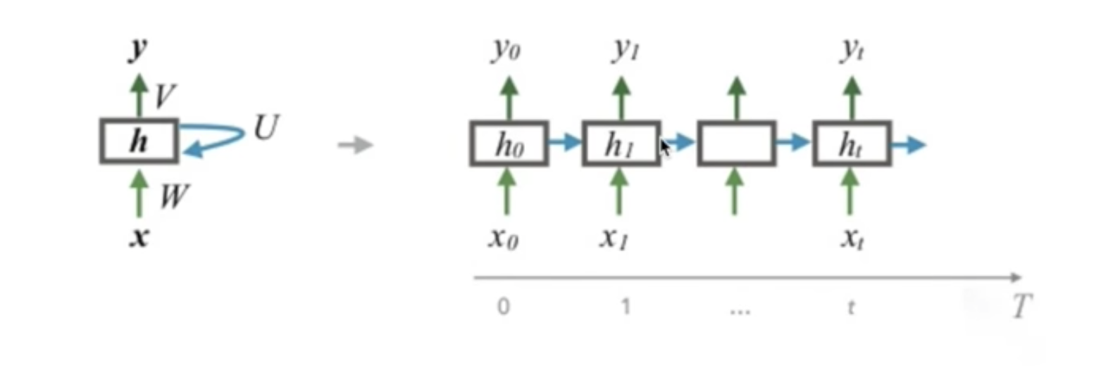
1. What is RNN? – Introduction (Cont..)
Other way of looking at the network
In this figure we have feed hidden layer back to itself.
This is unrolled (Right side) to understand it in better way.

Slide 13
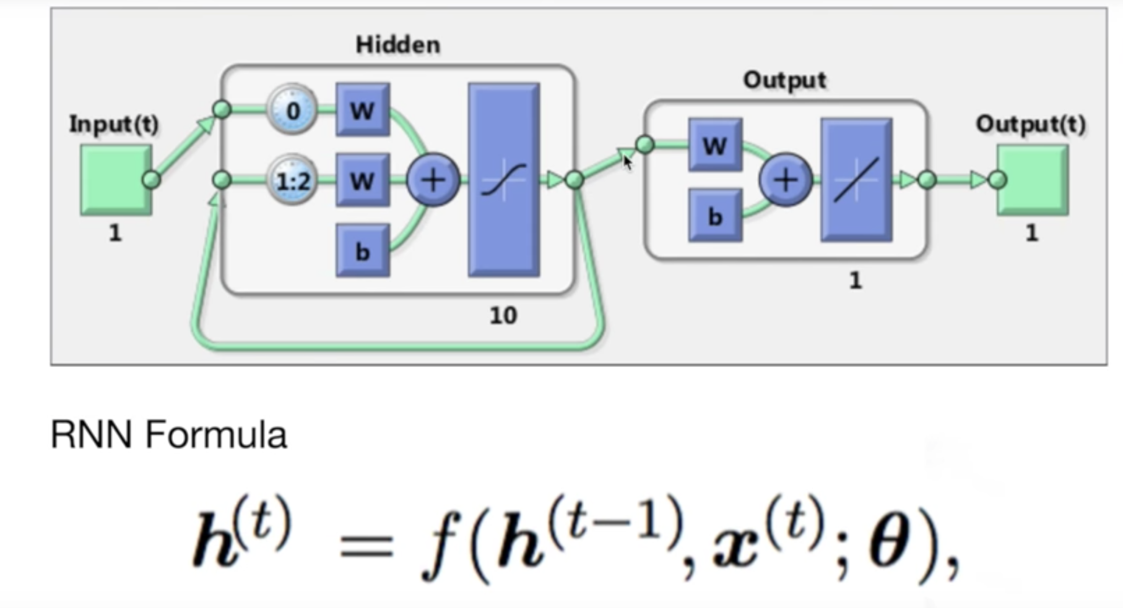
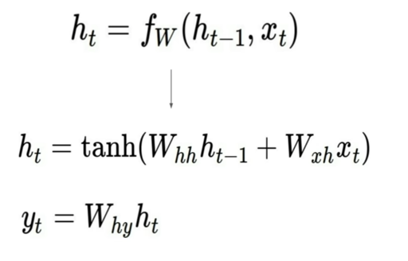
1. What is RNN? – Introduction (Cont..)
May be more clear representation!!
Notes:
Same as NN
Only extra term is W_{hh}h_{t-1}
W_{hh} is hidden to hidden layer weight as we saw

Slide 14
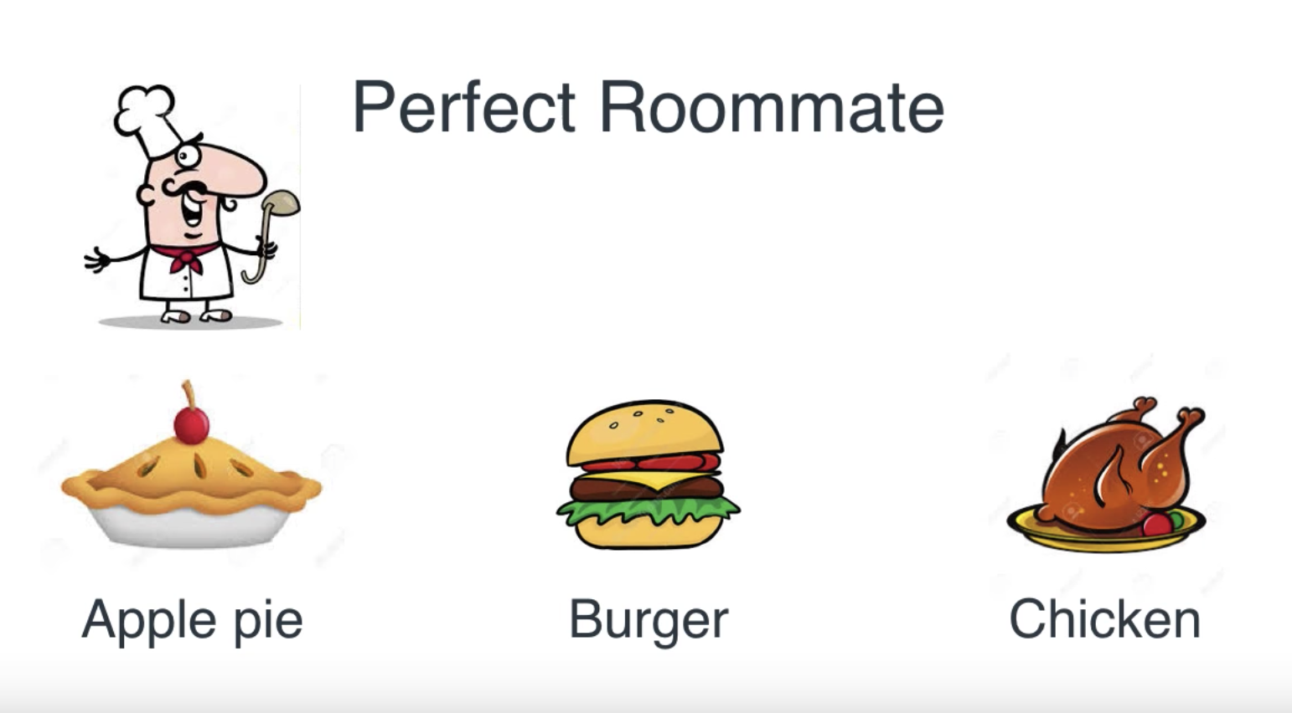
2. RNN Example
Let’s begin with the very famous “Perfect Roommate” example.
Scenario 1
RNN Example slide images are taken from Luis Serrano’s lecture. https://www.youtube.com/watch?v=UNmqTiOnRfg
Notes:
We have a perfect roommate
Cooks everyday three type of food – Apple Pie, Burger and Chicken
He has a rule for what he cooks

Slide 15
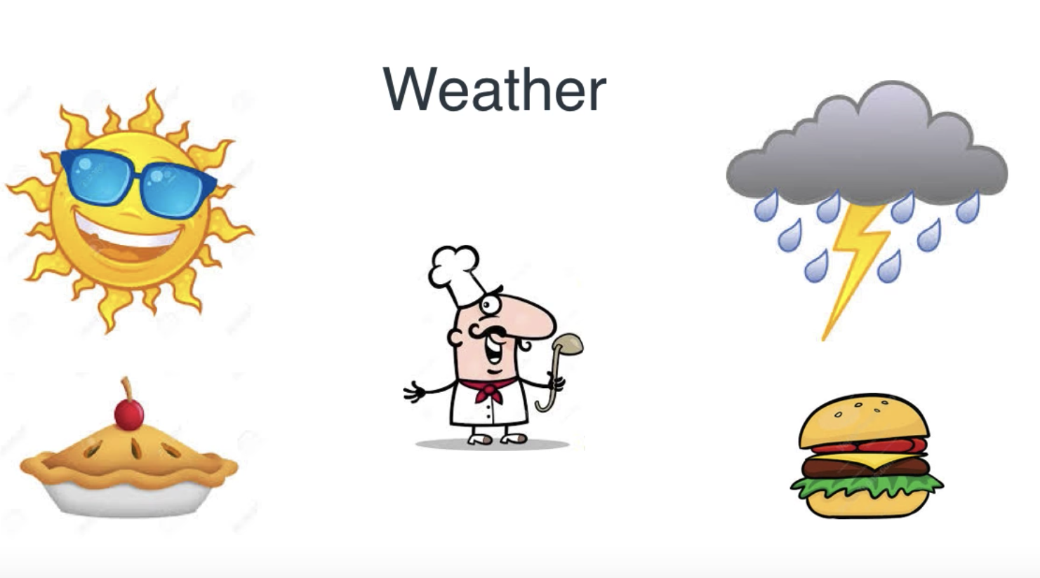
2. RNN Example (Cont..)
Apple Pie
NN
Sunny
Burger
NN
Rainy
Notes:
His Rule
If sunny he cooks apple pie
If rainy he cooks burger

Slide 16
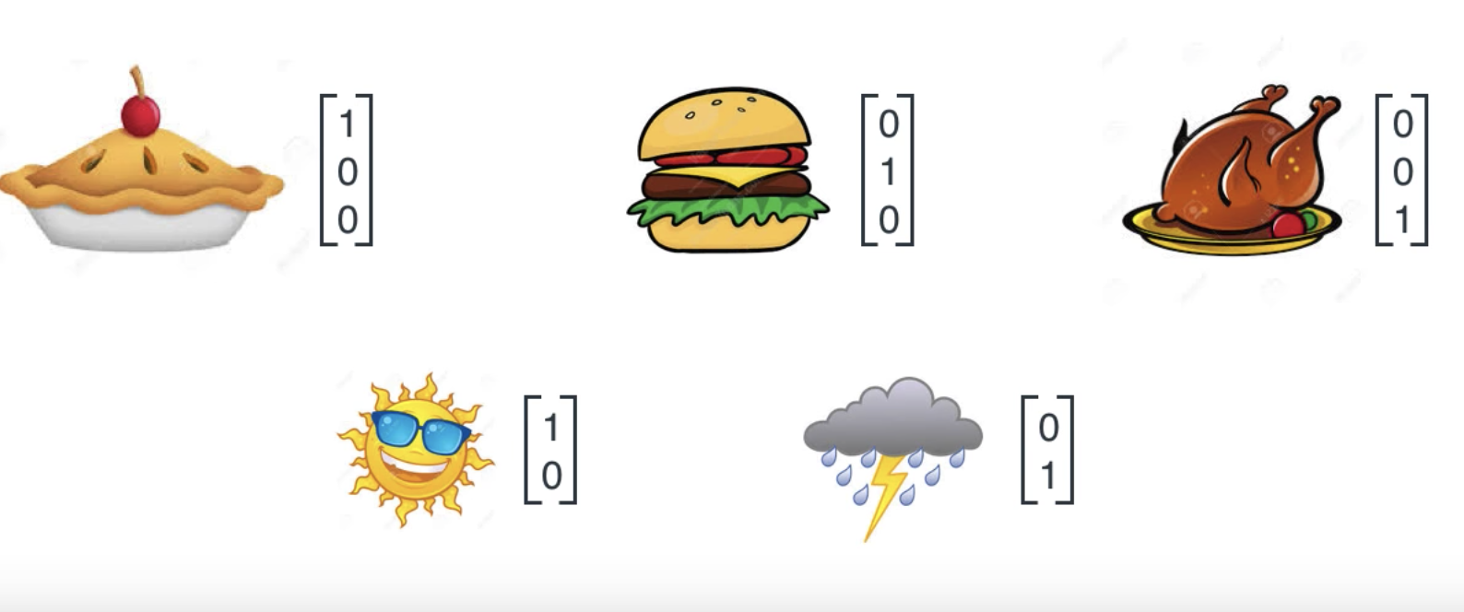
2. RNN Example (Cont..)
In Vector form:
Notes:
Computer understands only in terms of numbers.

Slide 17
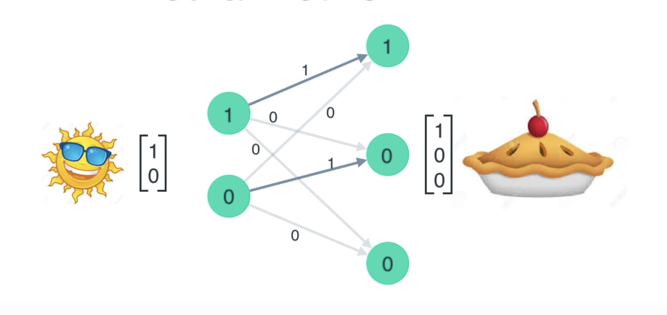
2. RNN Example (Cont..)
Notes:
This was simple NN.

Slide 18
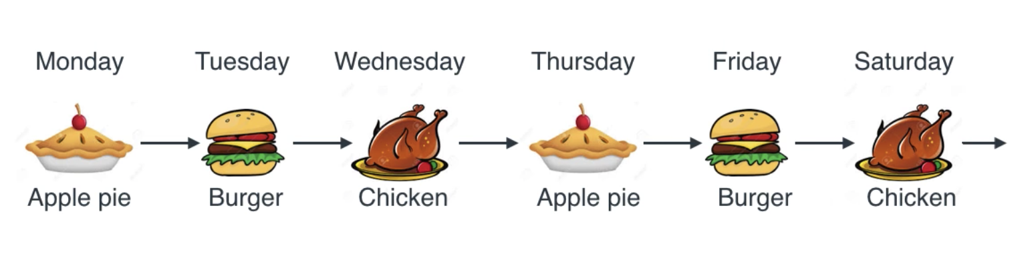
2. RNN Example (Cont..)
Scenario 2
Notes:
Now he doesn't care about weather.
He cooks in sequence.
This is not simple NN. This is RNN.

Slide 19
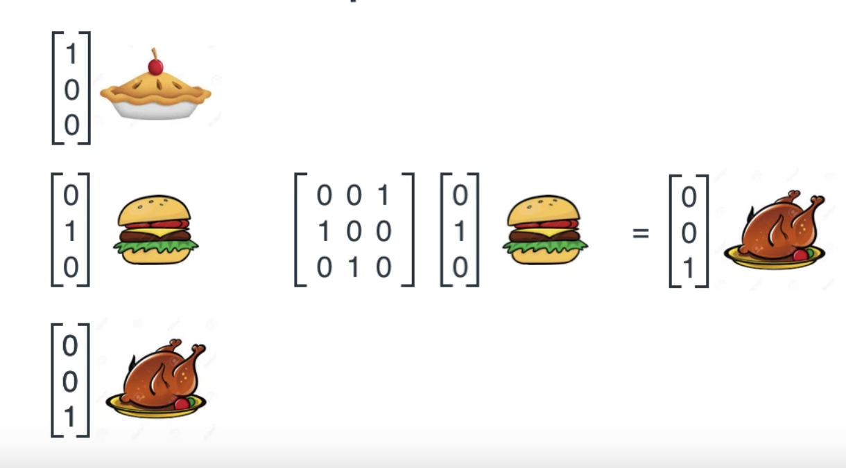
2. RNN Example (Cont..)
Notes:
We define this matrix.
Linear map that maps item to next item.

Slide 20
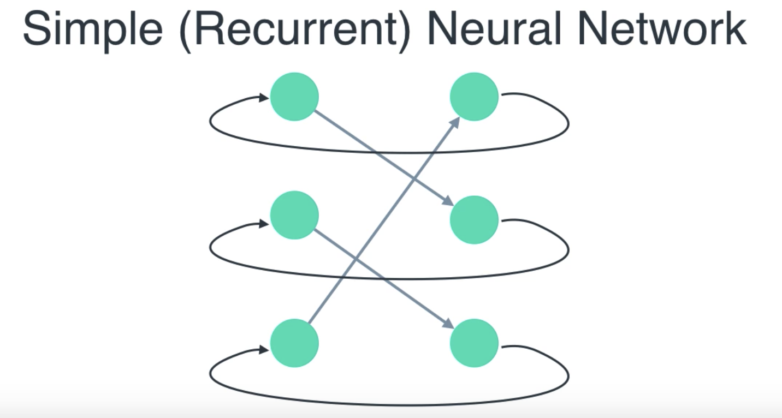
2. RNN Example (Cont..)

Slide 21
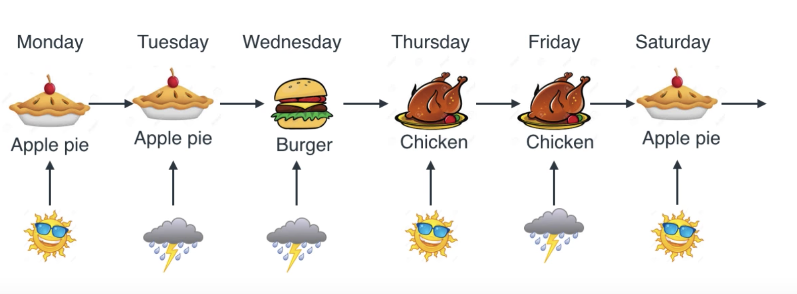
2. RNN Example (Cont..)
Scenario 3
Notes:
He cooks in sequence but he has some rule also. It depends on weather. Combination of previous 2 scenarios.
If Sunny, he doesn’t cook and give us yesterday's leftover
If rainy, he cooks next dish.

Slide 22
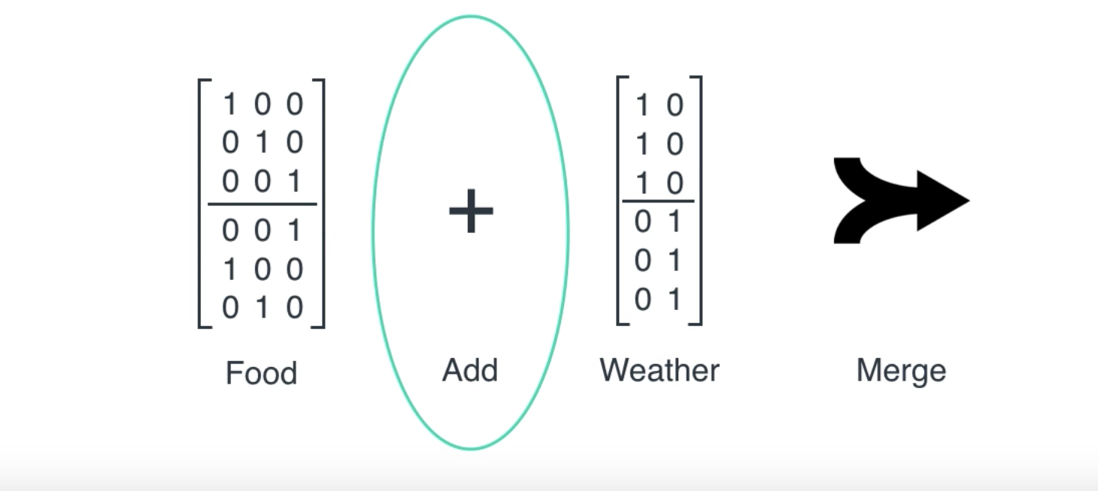
2. RNN Example (Cont..)
Notes:
Food matrix is actually 3X6. But represented as two 3X3 concatenated.
. What is does is it returns same food and next day food.
Weather matrix is also two concatenated matrices. Two 3X2

Slide 23
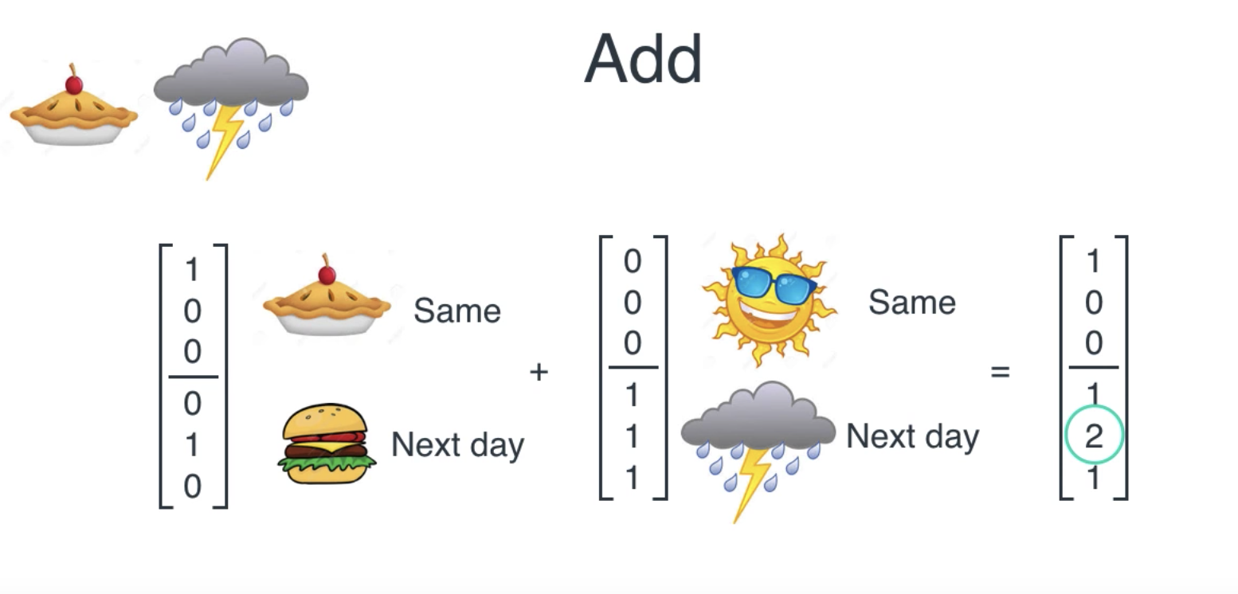
2. RNN Example (Cont..)

Slide 24
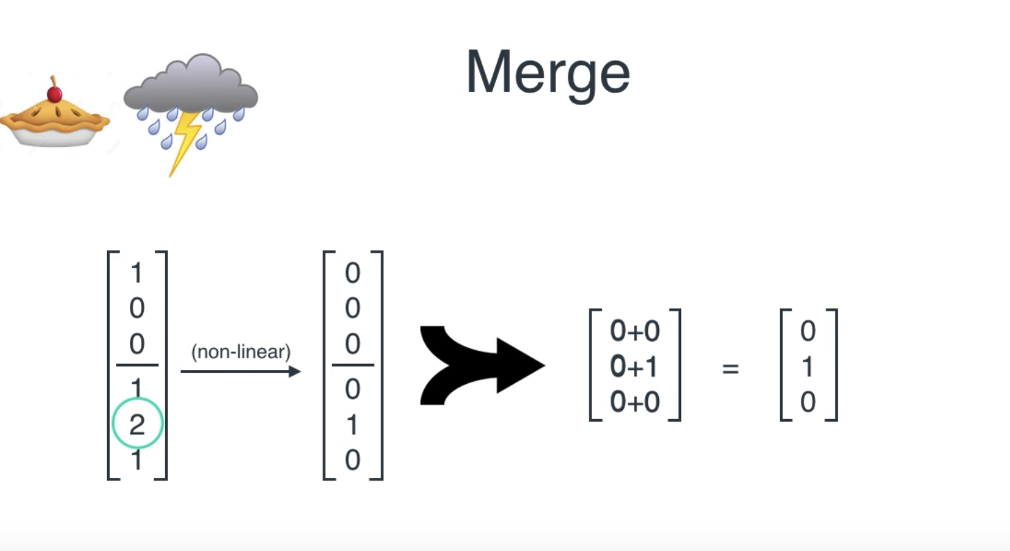
2. RNN Example (Cont..)

Slide 25
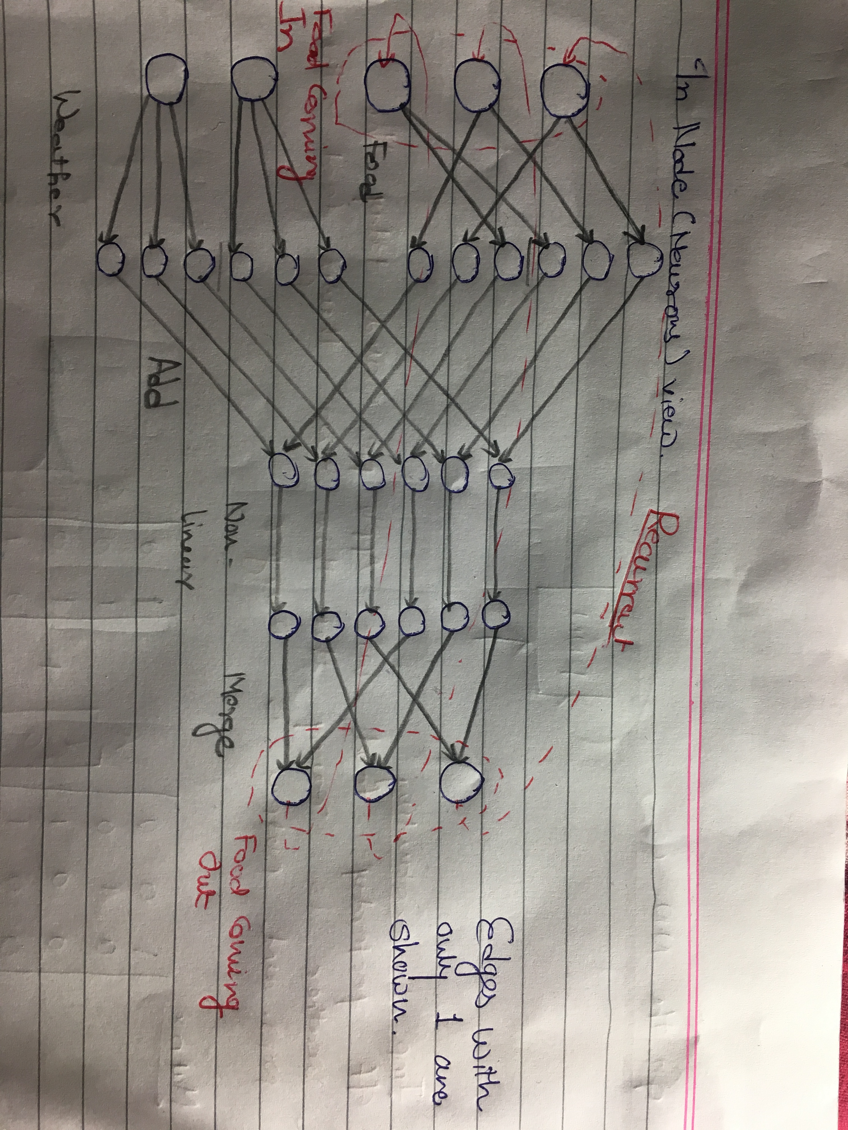
2. RNN Example (Cont..)

Slide 26
3. Vanishing and exploding Gradient in Vanilla RNN
I am from France. I live in Paris….. I have studied Computer Engineering. I speak … fluently??
We need to go back in time to know the context and this is complex task. We have long term dependencies.
Includes lot of iterations and so the change in weight will be very small.
New weight ~ Old weight → No training.
Notes:
I am from France. I live in Paris. I have studied Computer Engineering. I speak …??

Slide 27
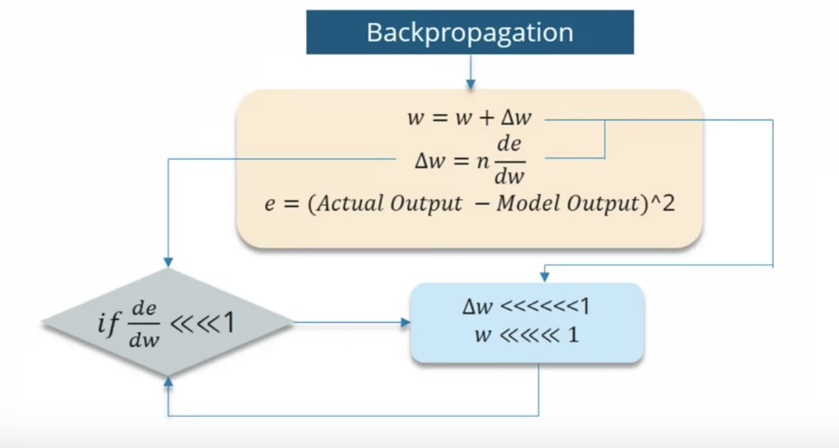
3. Vanishing and exploding Gradient in Vanilla RNN (Cont..)

Slide 28
3. Vanishing and exploding Gradient in Vanilla RNN (Cont..)
Exploding gradient is just opposite of vanishing gradient problem
New weight will be completely different that old weight
Model will never converge.
HOW TO SOLVE THIS PROBLEMS?
Using different network architecture that are specially designed to combat these issues.
LSTM, GRUs

Slide 29
4. LSTM
Long Short Term Memory
Special kind of RNN
Capable of learning long-term dependencies
Notes:
LSTM not required here: The grass is …

Slide 30
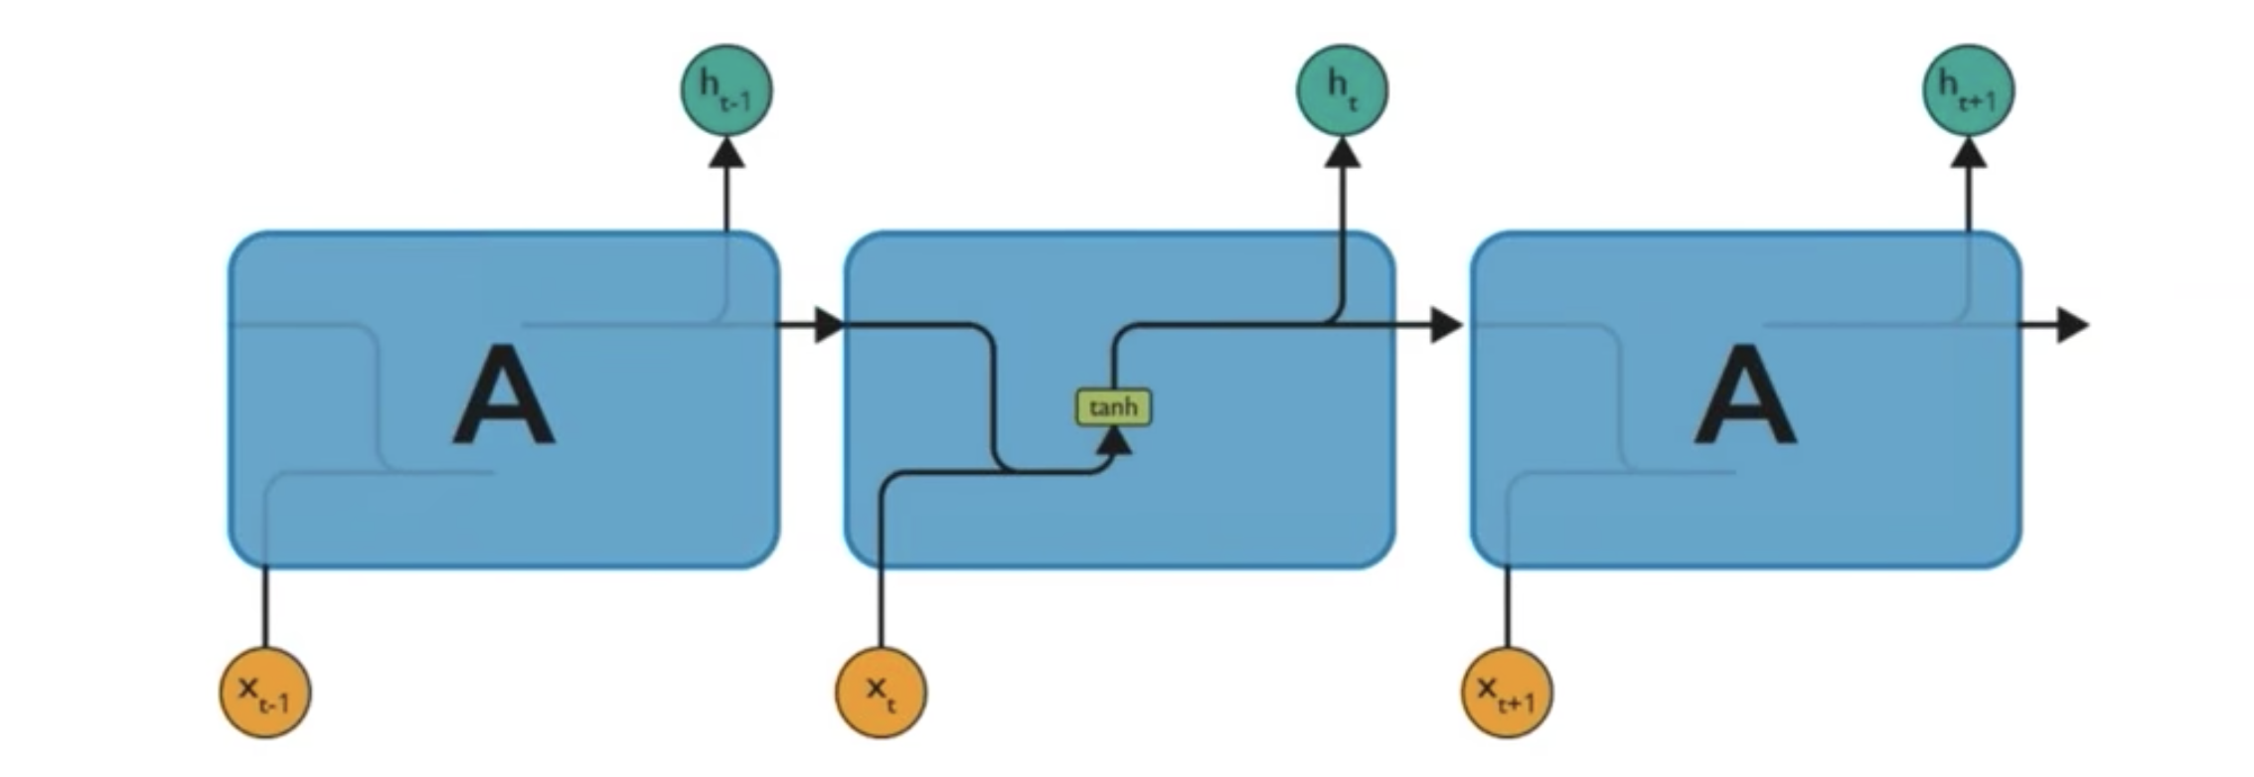
4. LSTM (Cont..)
Simple RNN Network
Notes:
Simple RNN
Tanh squashing function (Non linearity) -1 to 1.

Slide 31
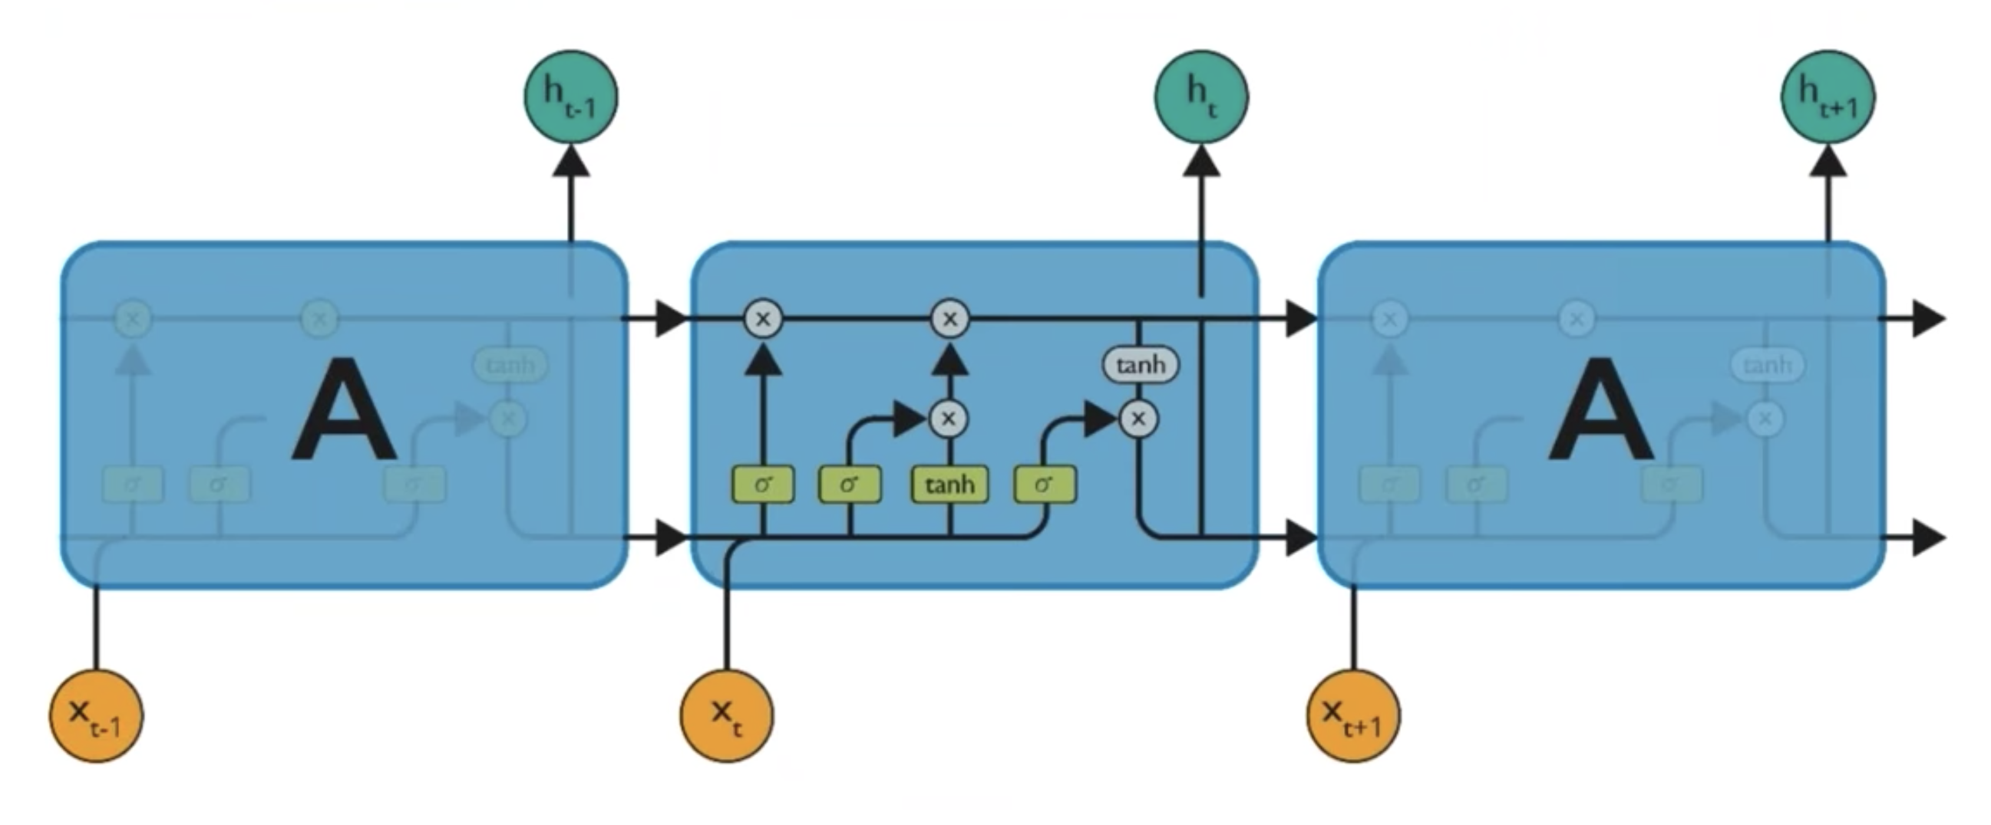
4. LSTM (Cont..)
LSTM Network architecture
Notes:
Horizontal line is a cell state and which is the most important part in LSTM.

Slide 32
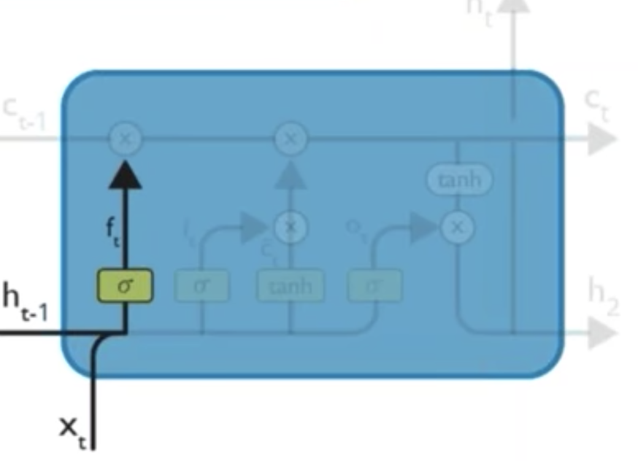
4. LSTM (Cont..)
Step by Step analysis of LSTM
Step 1
Identify information that are not required and thrown away from Cell state.
Decision is made by Sigmoid gate (Forget Gate)
Notes:
Sigmoid provides 0 and 1 for input using previous hidden layer.
Eg. If we have a new subject (New gender) then we want to forget the gender of previous subject.

Slide 33
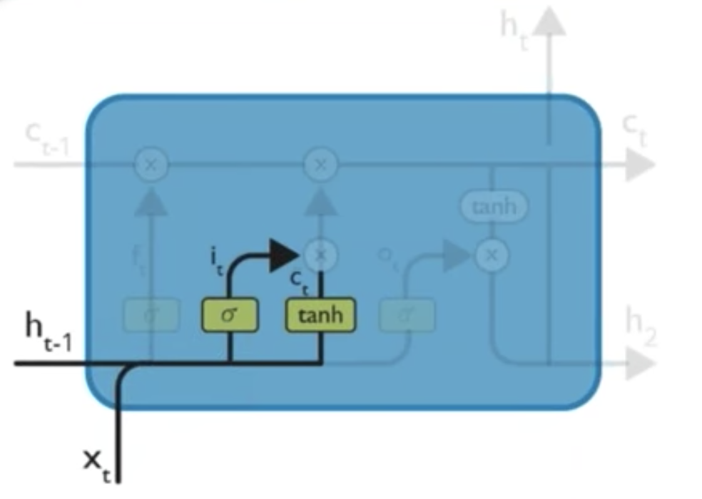
4. LSTM (Cont..)
Step 2
What information we are going to store in Cell state.
Sigmoid layer called input gate layer decides which values will be updated.
tanh layer creates a vector of new candidate values, that could be added to the state.

Slide 34
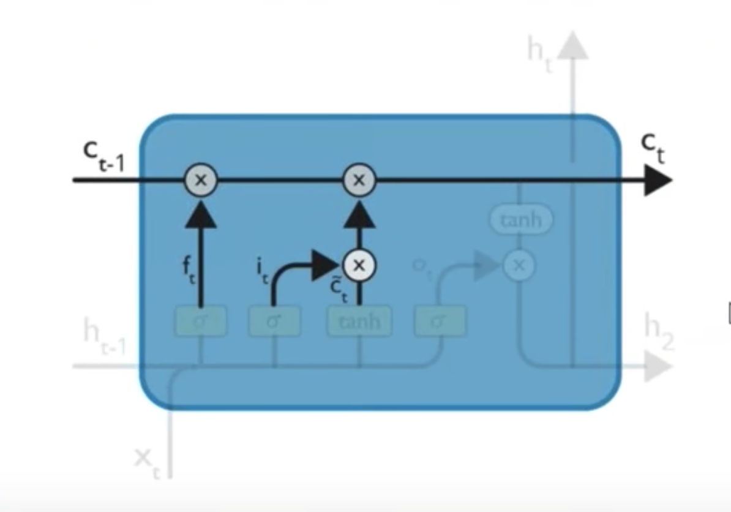
4. LSTM (Cont..)
Step 3
Update the old state with new state.
First multiply C_{t-1} with f_{t} and forgetting what we have decided earlier.
Then add i_{t} * C_{t}(bar) to that. This is the new candidate values, scaled by how much we decided to update each state value.

Slide 35
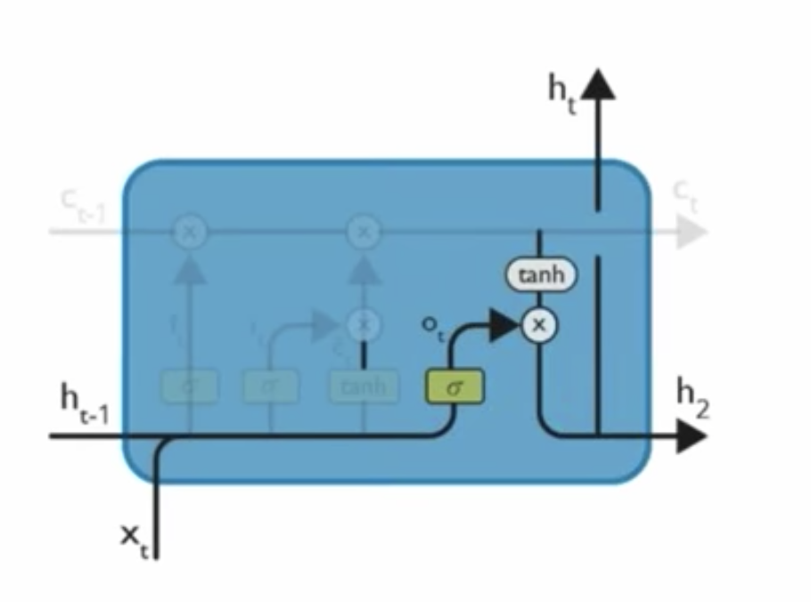
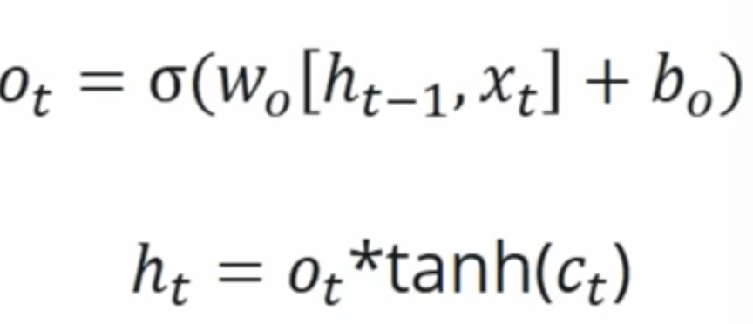
4. LSTM (Cont..)
Step 4
What we are going to output.
Output will be depend on cell state (Filtered version)
First get O_{t}.
Then pass C_{t} to tanh to get it squashed.
Multiply both to get h_{t}

Slide 36
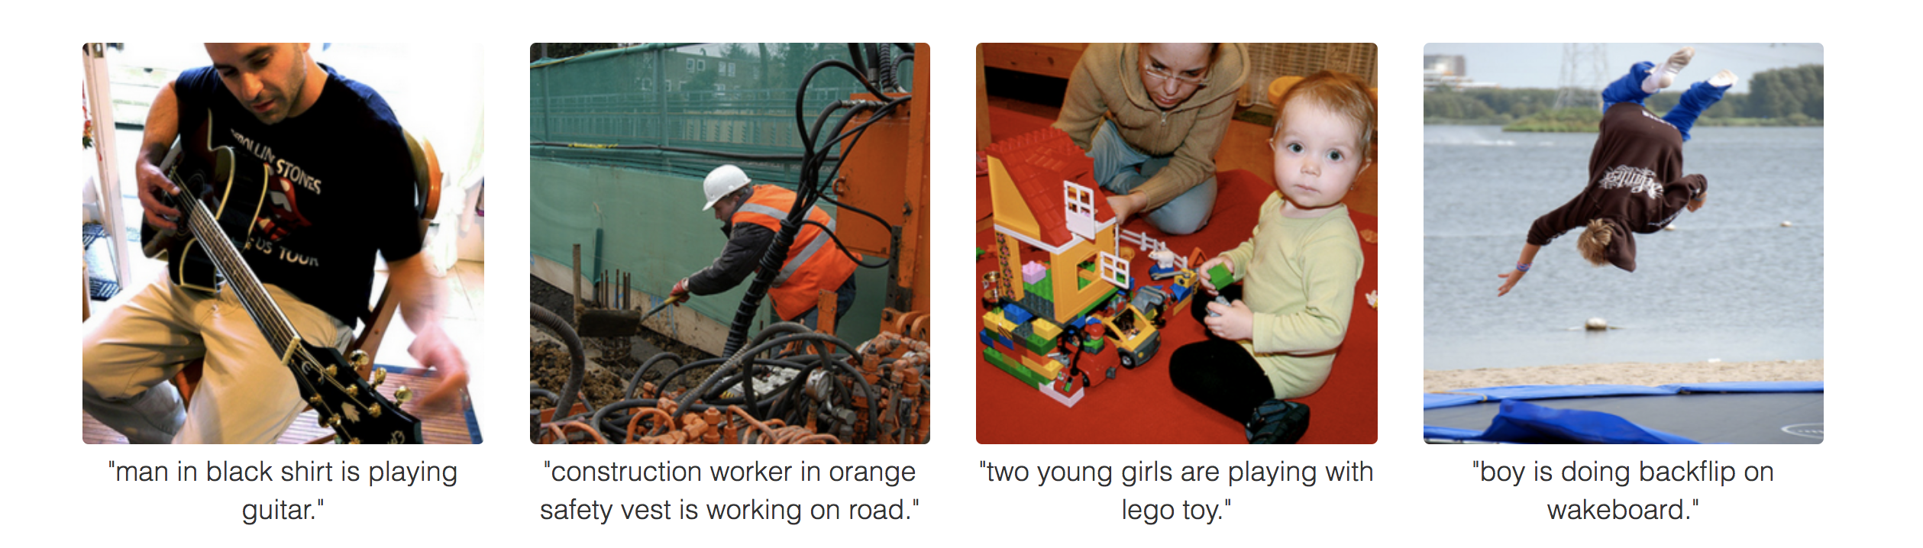
Some Cool things…

Slide 37
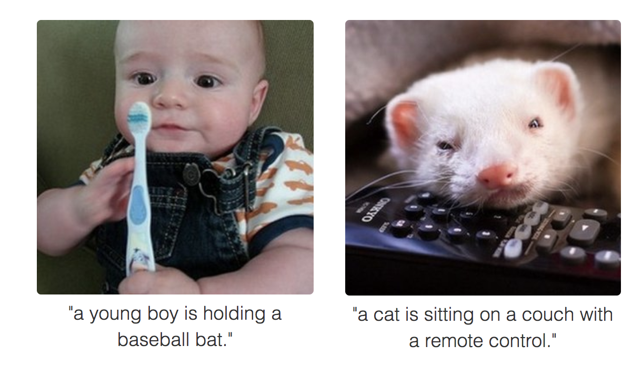
What about these??

Slide 38
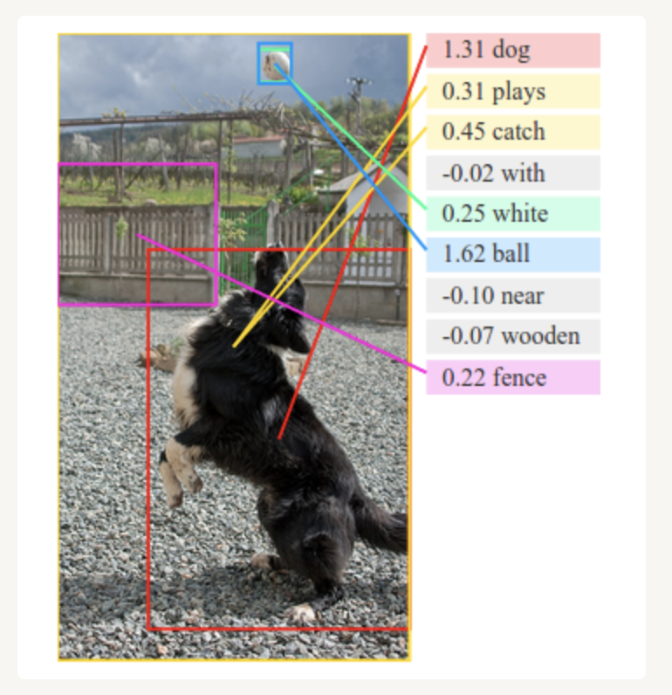
And this..

Slide 39
Part 2 – German Traffic Sign Classification
Discuss Notebook.

Slide 40
Reference Slides

Slide 41
